Slide 1
Method Overriding in Java
momedaram

Slide 2
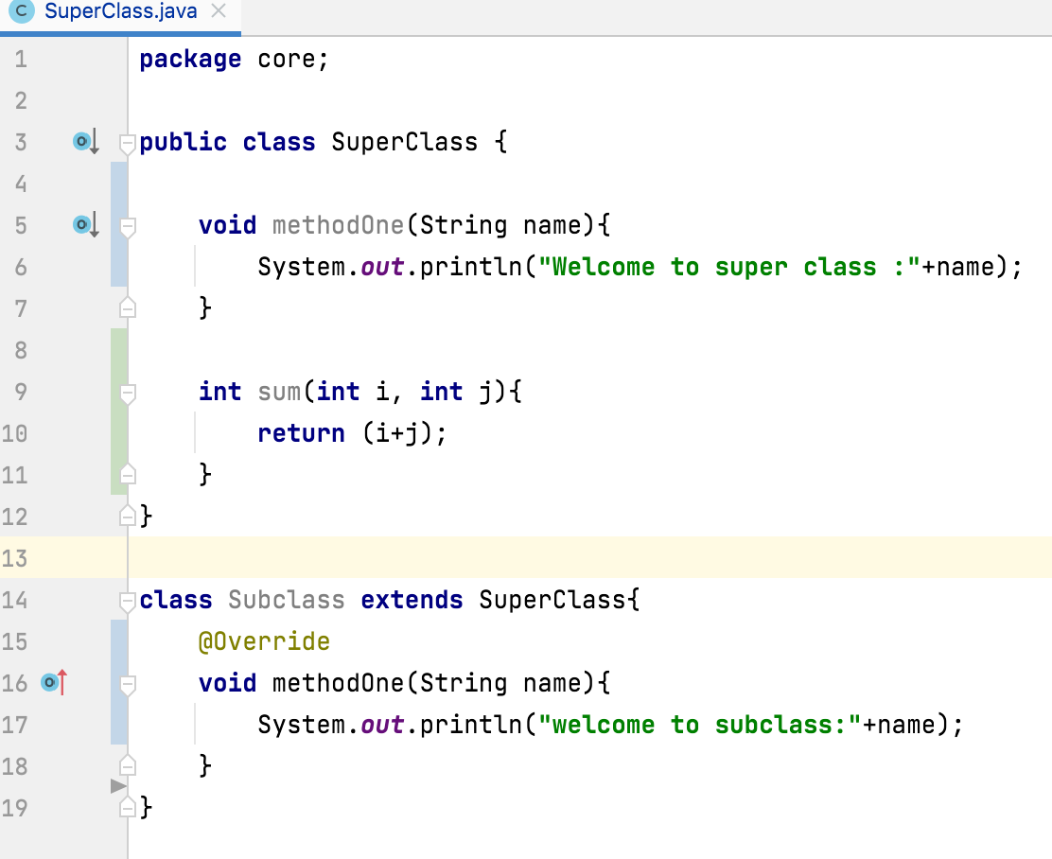
Method Overriding in Java
Overridden method
If a class extends its super class, all or some members of super class are inherited to sub class.
The process of modifying the super class methods in sub class is know as method overriding.
Overriding method

Slide 3
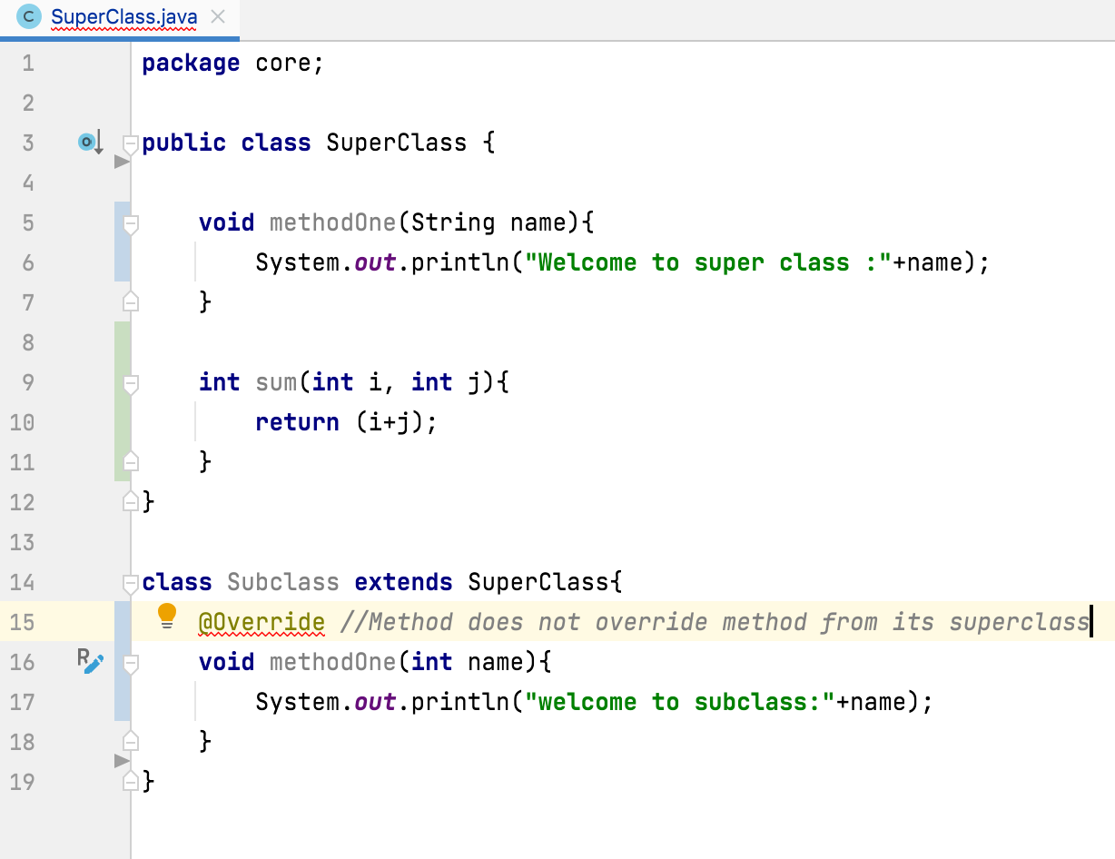
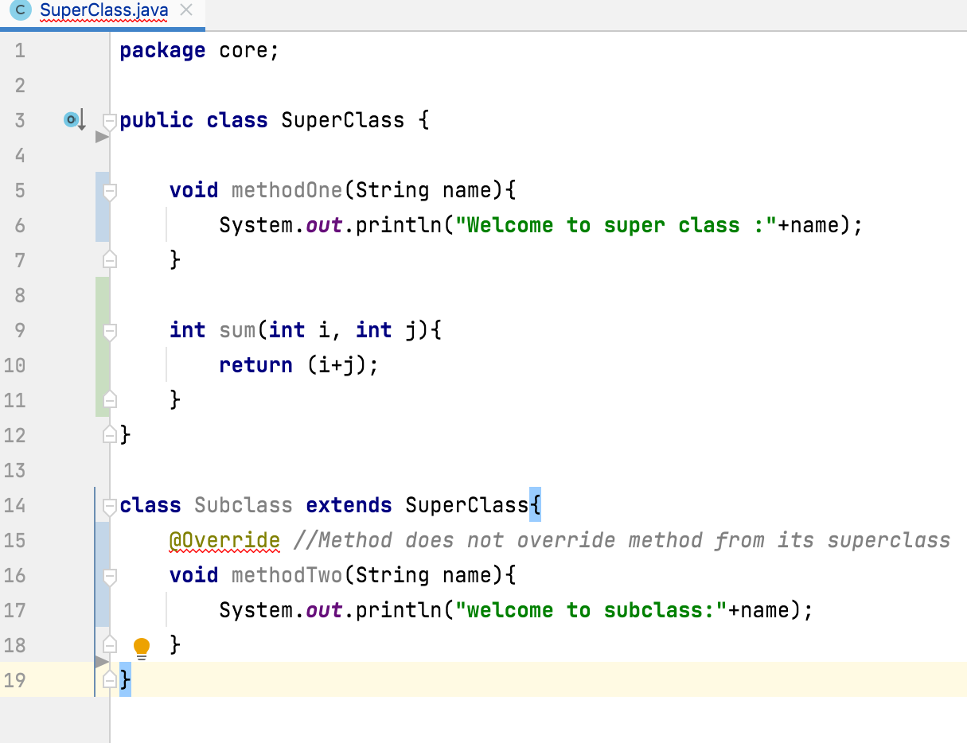
Name and Arguments of overridden method must be same as in the super class. We can’t change name and arguments of the method in subclass.

Slide 4
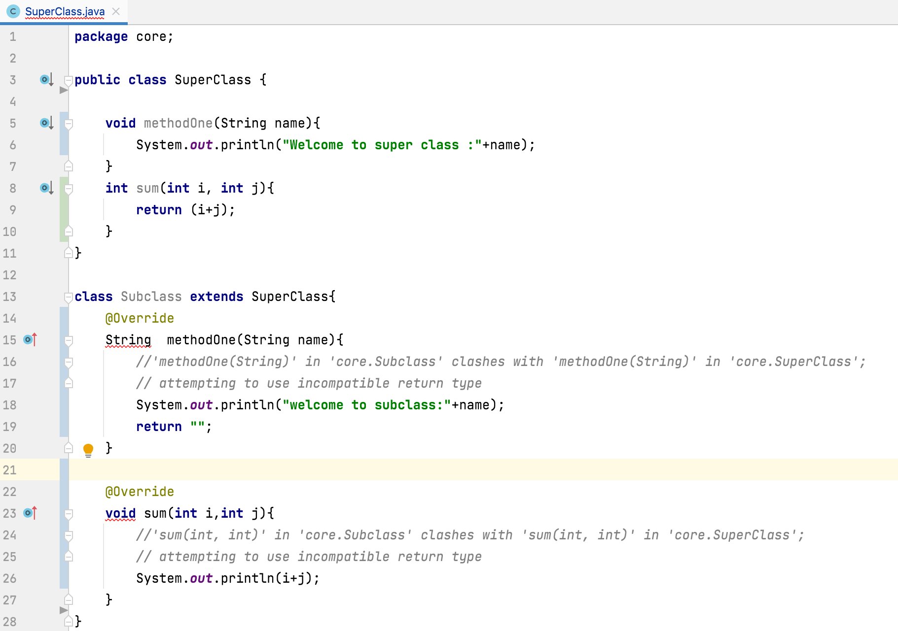
The return type of the overrided method must be compatible with super class method.
super class method subclass method
primitive primitive
derived / user defined derived type or its sub class.

Slide 5
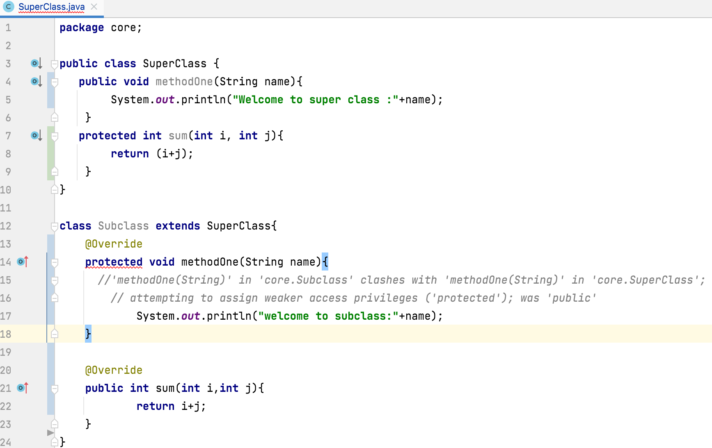
Visibility Of Overrided method
we can keep same visibility or increase the visibility of overrided method, but we can’t reduce the visibility of overrided methods in the subclass.

Slide 6
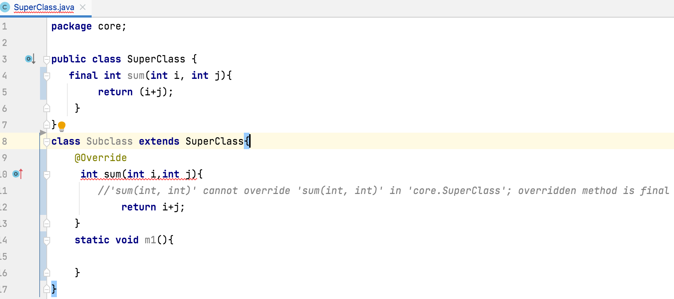
Note:
Private methods are not visible in the sub classes, hence overriding concept is not applicable for private methods.
we cannot override static methods because method overriding is based on dynamic binding at runtime and the static methods are bonded using static binding at compile time.
Final methods can’t override

Slide 7
Thank you !
momedaram

